Slide 1
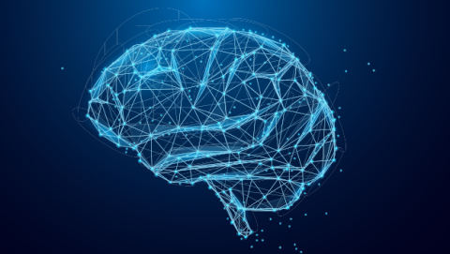
Artificial Intelligence

Slide 2
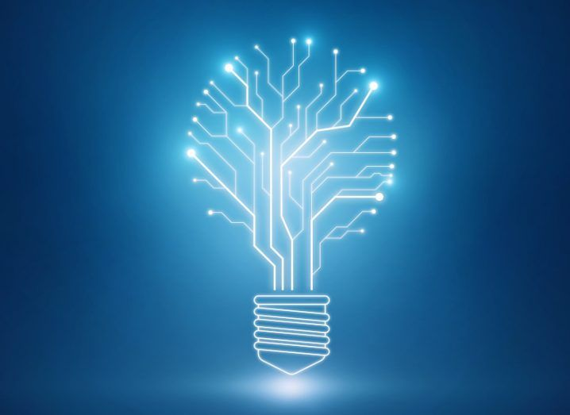
Introduction
AI is made up of 2 words
Aritifical : Product made by humans Intelligence : Ability to learn and solve problems
Artificial Intelligence is: 1) Ability to solve problems 2) Ability to act rationally
3) The ability to act like humans

Slide 3
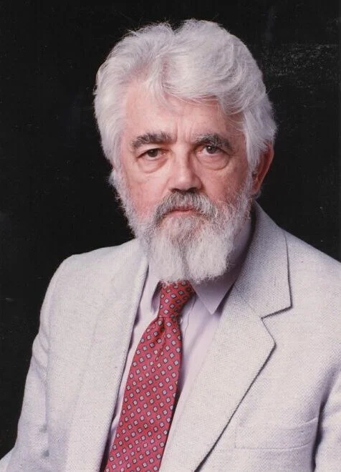
History of AI
In 1950, it just started and all AI devices were in development phase.
In 1955, John McCarthy coined the term “Aritificial Intelligence”.
In 1974, computers became faster and affordable.
In 1980, majority of AI were launched.
AI like Siri and Alexa were launched in 2011 and 2014 respectively.

Slide 4
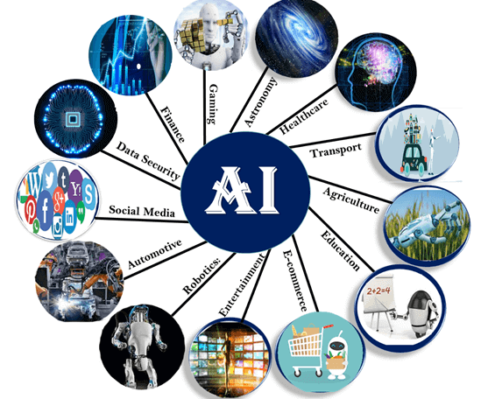
Applications of AI
Autonomous vehicles such as drones and self driving cars.
Medical diagnosis
Proving mathematical theorems
Playing games such as chess
Search engine such as google
Online assistant such as Siri
Spam Filtering etc.

Slide 5
Advantages
Disadvantages
More Powerful and useful computers
New and improved interfaces
Solving new problems
Better handling of Information
Increased costs
Difficulty in software development
Few experienced programmers
Few practical products have
Reached the markets yet

Slide 6
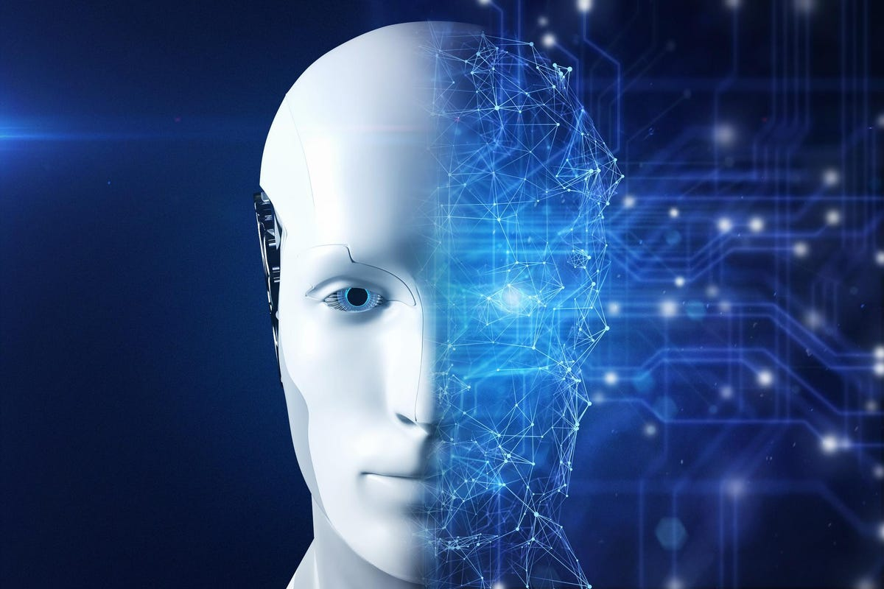
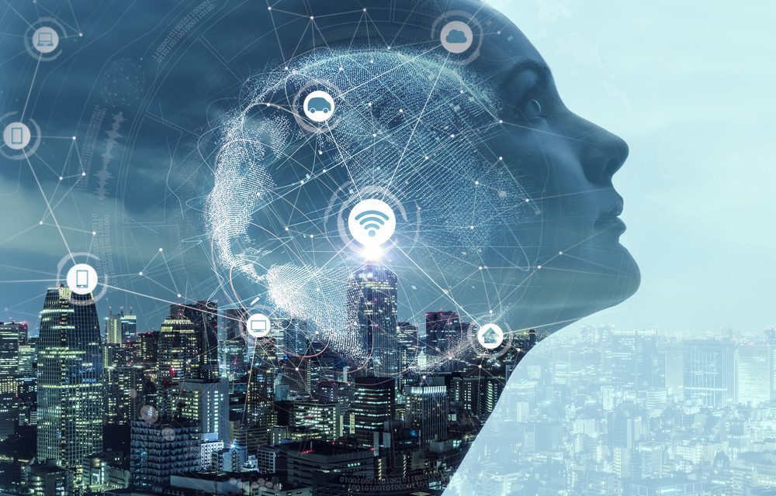
Future of AI
Looking at todays technology , InFuture more advanced technology AI
will be launched . The AI made by humans may be of more intelligence.
This can be taken both as good and bad . Good because more advanced AI
Technologies will be launched which make our work simplified and bad because, in
future AI technology can replace humans as they makes us lazy and lacks creativity.

Slide 7
Thank you

